Slide 1

Sales Data Analysis Report
By – Shalini Pal

Slide 2

Introduction
Amazon.com is an American multinational technology company focusing on e-commerce, cloud computing, online advertising, digital streaming, and artificial intelligence.
Sales management has gained importance to meet increasing competition and the need for improved methods of distribution to reduce cost and to increase profits. Sales management today is the most important function in a commercial and business enterprise

Slide 3
Project Title - | Analyzing Amazon Sales Data
Technologies - | Data Science
Domain - | E-Commerce

Slide 4







Technologies Used –

Slide 5
KPI’s (Key Performance Indicators)
Units Sold - total number of units of products sold over a specific period,
Revenue - total sales revenue generated from the sale of products on Amazon.
Cost - total cost incurred in sourcing, manufacturing, and delivering products to customers, including procurement costs, manufacturing costs, shipping costs, and fulfillment fees.
Profit - the net profit earned from Amazon sales after deducting all costs and expenses.

Slide 6
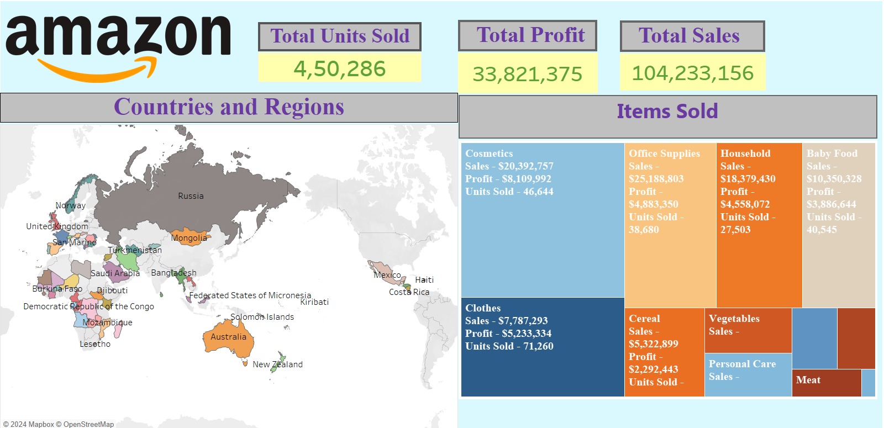
Sales by Location

Slide 7
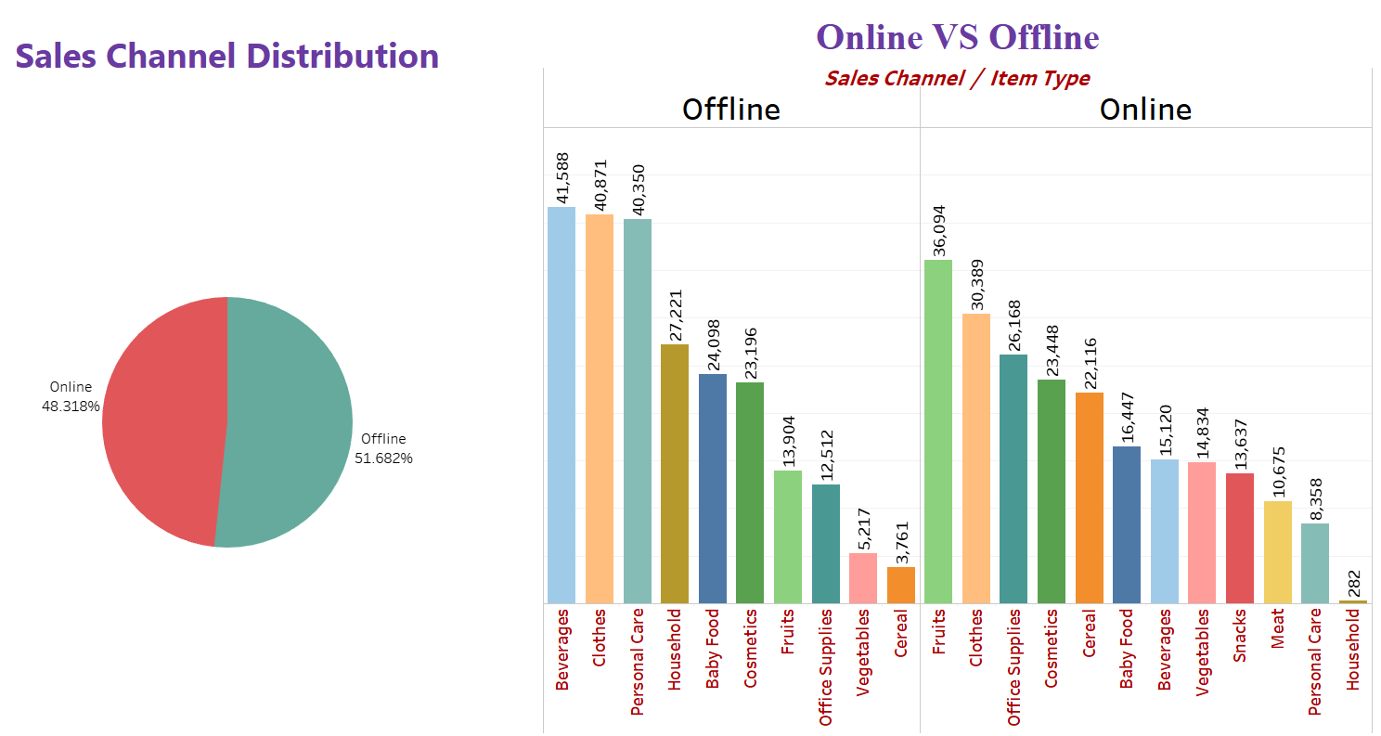
Sales By Channel

Slide 8
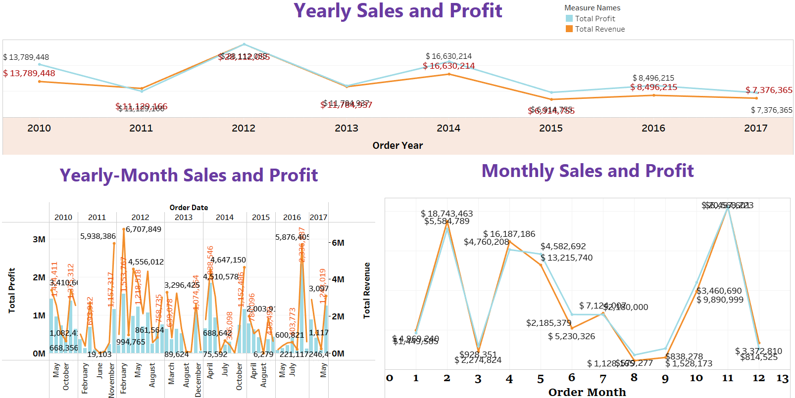
Yearly, Monthly and Yearly-Month wise Sales

Slide 9
Thank You!

